Slide 1
APPROACH TO ANEMIA
Lecturer. Dr. Joel Solórzano Romero

Slide 2
Topic
DEFINITION
EPIDEMIOLOGY
CLASIFICATION
CLINICAL MANIFESTATIONS
DIAGNOSIS, TREATMENT

Slide 3
Definition of anemia
From Greek meaning “without blood” •Condition where capacity of blood to transport oxygen to tissues is reduced
Anemia is operationally defined as a reduction in one or more of the major RBC measurements: Decreased hemoglobin, RBC count, and hematocrit.
Hb level of a patient which is below the normal ranges of that age and sex.
For adults:
WHO criteria define anemia as hemoglobin level lower than 12 g/dL in women and 13 g/dL in men
Anemia is not a disease but a manifestation of disease

Slide 4


Slide 5
Background
Iron deficiency is the most common form of malnutrition in the world. Iron deficiency anemia is highly prevalent in less-developed countries but also remains a problem in developed countries where other forms of malnutrition have already been virtually eliminated.
The prevalence of anemia, defined by low hemoglobin or hematocrit, is commonly used to assess the severity of iron deficiency in a population

Slide 6
CONSECUENCE OF ANEMIA
Reduced levels of Hb results with reduced oxygen delivery to tissues , leading to tissue hypoxia.
The symptoms and findings of anemia concern many different systems/organs due to the widespread nature of hypoxia.

Slide 7
Compensating mechanisms in anemia
The rate of blood circulation and cardiac output increases.
An increase in plasma volume maintains total blood volume in normal or near normal ranges.
Redistribution of blood flow.

Slide 8
Physiological Response
↓oxygen carrying capacity
Shift to right
↑ 2,3-DPG
↑ Cardiac output
Circulation shifts to critical areas
↑ RBC production
↑ Erythropoietin
Left shift on blood smear
↑ Reticulocyte count

Slide 9
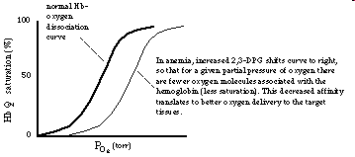
Compensating mechanisms in anemia:
The release of oxygen to the tissues is increased (reduced oxygen affinity of Hb)

Slide 10
Volume changes/acute bleeding and anemia
1
2
3
4
5
b
a
Increased plasma volume Hct: Low
normal
Hct (a/b%):Normal
Dehydration Hct:Increased
Acute blood loss(early) Hct:unchanged
Chronic anemia Hct: Low

Slide 11
Etiopathogenic
Classification of Anemias
Decreased RBC production( Hypoproliferative)
  Defective hemoglobin synthesis
  Fe deficiency
  B12 deficiency
  Folate deficiency
  b. Impaired bone marrow or stem cell function, as in leukemia
Erythrocyte loss :
  Increased RBC destruction e.g hemolytic anemia.
  Bleeding
Combination of the two (sometimes called “ineffective erythropoiesis”)

Slide 12
Morphological
Classification of Anemias
Morphological based on sizes and color of RBCs
  Normochromic Normocytic
  Hypochromic Microcytic
  hyperchromic Macrocytic

Slide 13
Quantitative
Classification of Anemias
Quantitatively by:
  Hematocrit
  Hemoglobin
  Blood cell indices
  Reticulocyte count
On basis of H&H, anemia can be classified as mild, moderate, or severe.
On basis of duration of onset, anemia can be classified as either chronic or acute.
Classified as moderate (Hb 7-10 g/dl) or severe (Hb <7g/dl).

Slide 14
Diagnosis and investigation:
Is the patient anemic?
What is the type of anemia?
What is the cause of anemia?

Slide 15
The symptoms and findings are related to anemia itself or to the underlying disease that causes anemia .

Slide 16
Clinical Diagnosis
Made by combination of factors including: patient history, physical signs and changes in hematologic profile (CBC).
Signs and symptoms usually non-specific: fatigue, weakness, gastrointestinal symptoms (nausea, constipation and diarrhea), shortness of breath - especially after exertion.
Physical signs of anemia are usually not specific for the cause.

Slide 17
Some Other examples for history and physical examination
The duration of symptoms (acute/insidious)
Bleeding ? Nose/skin/urine/mens/stool etc
Family history
  Anemia, gall stones and splenectomy
  Bleeding disorder
Occupation, hobbies,dietary history,alcohol or drug use,travel history etc (toxic/infectious contacts)
Ask for skin and hair/nail changes

Slide 18
Clinical symptoms and findings of anemia
Anemia leads to two symptom complexes
Tissue hypoxia
Compensatory attempts
Fatigue, weakness
  Tiredness, lassitude, reduced exercise tolerence
  Generalized muscular weakness
Pallor /skin or mucous membranes

Slide 19
Pallor (paleness):
Look at
  Mucous membranes of mouth and pharynx
  Conjunctivae,lips, nail beds,palms
    Creases of the palms lose their pink colour when the Hb < 7g/dL
In pernicious anemia there is a lemon yellow pallor.
Pallor + mild scleral icterus suggests hemolytic anemia.
Pallor+ petechiae suggests severe bone marrow failure

Slide 20
Some other skin/mucosal changes
  Premature graying of hair:pern.anemia
  Hair loss and fragility + spooning of the nails:iron deficiency
  Chronic leg ulcers:Sickle cell or other hemolytic anemia
  Glossitis/burning sense :Pern. anemia, iron deficiency(rare)
  Chelitis(angular stomatitis):iron def.
  Siideropenic dysphagia: iron def.
  Painful ulcerative mouth lesions: aplastic anemia/leukemia

Slide 21
Clinical symptoms and findings of anemia
Cardiovascular System(1)
Palpitation and dyspnea (during activity)
Angina pectoris
Claudicatio intermittans
Murmurs: Mid systolic (rarely diastolic) , mainly pulmonary valvular or apical
or over major peripheral arteries
or jugulary veins

Slide 22
Clinical symptoms and findings of anemia
Central nervous system
Headache
Faintness
Giddiness
Tinnitus
Decreased concentration ability
Drowsiness,decreased muscle strength
Clouding of consciousness
Symptoms are more prominent in older patients
Paresthesias:Vitamin B12 deficiency (or other).

Slide 23
Clinical symptoms and findings of anemia
Reproductive system
Menstrual changes:
  Amenorrhea ,
  Menorrhagia(mostly a cause of anemia)
Loss of libido

Slide 24
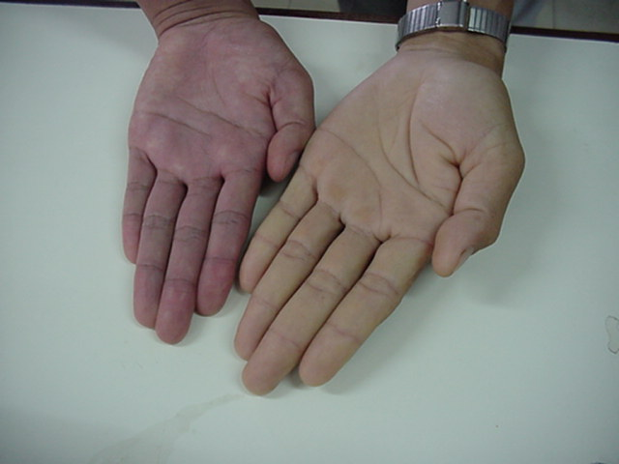

Slide 25
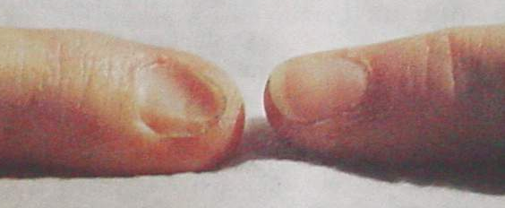
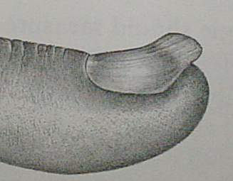
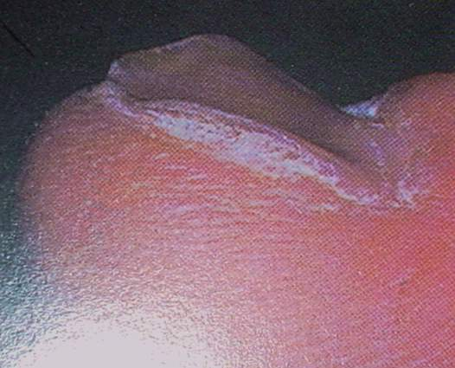
Koilonychia - spoon shaped nail

Slide 26
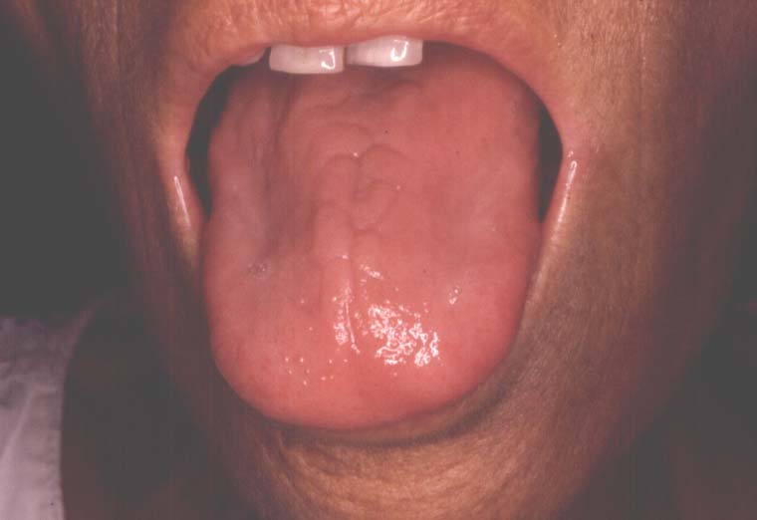
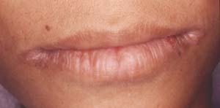
glossitis
Angular stomatitis
Nutritional deficiency anemia

Slide 27
Basic hematologic lab tests
• Complete blood count (CBC) –
Amount of hemoglobin – Number, size, and shape of red blood cells (RBCs) – Number of white blood cells (WBCs) and platelets – +/- automated WBC differential
• Manual differential/manual peripheral smear review
• Abnormalities that fall outside of established parameters result in manual review

Slide 28
Normals
COMPONENT | NORMAL RANGES
WBC | 4.8-10.8 x 10³/μL
RBC | Male 4.7-6.1 x 10⁶/μL; Female 4.2-5.4 x 10⁶/μL
Hgb | Male 14-18 g/dL; Female 12-16 g/dL
Hct | Male 42-52%; Female 37-47%
MCV | 80-100 fL
MCH | 27-31 pg
MCHC | 32-36%
RDW | 11.5-14.5%
Plt | 150,000-350,000/μL
Retic | 0.5-2.0%

Slide 29
Hypoproliferative Anaemias
Failure of cell maturation
Nuclear breakdown
Cytoplasmic breakdown
Folate or B₁₂ deficiency
Haem defect
Globin defect
Defective DNA synthesis
Fe
Phorph
Sickle cell A
Megaloblastic Anaemia
IDA, SA
Thalassemia

Slide 30
Reticulocyte Production Index
For example the RPI is calculated as follows
  Reticulocyte count 9%
  Hb content 7.5 g%
  Correction for Anaemia
  = 9 x (7.5 ÷ 15) = 9 x 0.5 = 4.5 %
  Correction for increased life span
  4.5 ÷ 2 = 2.25 %
  3. Thus, the RPI is 2.25

Slide 31
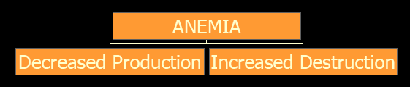
Anaemia
Hb% < 12, Hct < 38%
Hypoproliferative
Hemolytic
RPI < 2
RPI > 2

Slide 32
Mean Cell Volume (MCV)
RBC volume (rather) is measured by
The Mean Cell Volume or MCV and RDW
MCV
Microcytic
Normocytic
Macrocytic
< 80 fl
80 -100 fl
> 100 fl
< 6.5 µ
6.5 - 9 µ
> 9 µ

Slide 33
Anaemia Workup - MCV
MCV
Microcytic
Normocytic
Macrocytic
Iron Deficiency IDA
Chronic Infections
Thalassemias
Hemoglobinopathies
Sideroblastic Anemia
Chronic disease
Early IDA
Hemoglobinopathies
Primary marrow disorders
Combined deficiencies
Increased destruction
Megaloblastic anemias
Liver disease/alcohol
Hemoglobinopathies
Metabolic disorders
Marrow disorders
Increased destruction

Slide 34
Microcytic Anaemias
MCV < 80 fl | Serum Iron | TIBC | BM Perls stain
Iron Def. Anemia | ↓↓ | ↑↑ | 0
Chronic Infection | ↓↓ | ↓↓ | + +
Thalassemia | ↑↑ | N | + + + +
Hemoglobinopathy | N | N | + +
Lead poisoning | N | N | + +
Sideroblastic | ↑↑ | N | + + + +

Slide 35
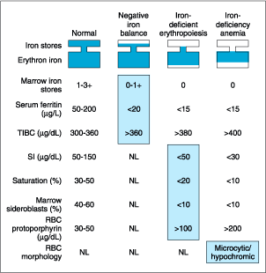
IDA – Special Tests
Iron related tests | Normal | IDA
Serum Ferritin (pmo/L) | 33-270 | < 33
TIBC (µg/dL) | 300-340 | > 400
Serum Iron (µg/dL) | 50-150 | < 30
Saturation % | 30-50 | < 10
Bone marrow Iron | ++ | Absent

Slide 36
IDA Summary
Microcytic MCV < 80 fl, RBC < 6 µ
RDW Widened and shift to left
Hypochromic MCH < 27 pg, MCHC < 30%
RPI < 2
Retic. count May be > 2 %
Serum ferritin Very low < 30 (p mols/L)
TIBC Increased > 400 (µg/dL)
Serum Iron Very low < 30 (µg/dL)
BM Fe Stain Absent Fe
Response to Fe Rx. Excellent

Slide 37
Macrocytic Anaemias
A. Megaloblastic Macrocytic – B12 and Folate↓
B. Non Megaloblastic Macrocytic Anaemias
  Liver disease/alcohol
  Hemoglobinopathies
  Metabolic disorders, Hypothyroidism
  Myelodystrophy, BM infiltration
  Accelerated Erythropoesis - ↑destruction
  Drugs (cytotoxics, immunosuppressants, AZT, anticonvulsants)

Slide 38
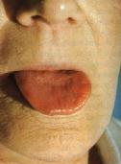
Pernicious Anaemia - Tongue
Bald, smooth, lemon yellowish red tongue

Slide 39
Non-specific signs and symptoms of anemia • Macrocytic anemia • Relatively low reticulocyte count • Hypersegmentation of neutrophils • Mild thrombocytopenia and/or neutropenia • Megaloblastic changes in marrow • Neurological findings (B12 deficiency only): loss of position sense, ataxia, psychomotor retardation, seizures

Slide 40
Normocytic Anaemias
Chronic disease
Early IDA
Hemoglobinopathies
Primary marrow disorders
Combined deficiencies
Increased destruction
Anaemia of investigations -ICU

Slide 41
Evaluation of Normocytic Anemia
PB smear, reticulocyte count
• Screen for liver, endocrine, renal disease
• Iron studies
• Bone marrow biopsy

Slide 42
Hemolytic Anaemia
Anemia of increased RBC destruction
– Normochromic, normocytic anemia
– Shortened RBC survival
– Reticulocytosis – due to ↑ RBC destruction
Will not be symptomatic until the RBC life span is
reduced to 20 days – BM compensates 6 times

Slide 43
Hemolytic Anemia
Inherited hemolytic anemia .
Membrane defects (eg. hereditary spherocytosis)
– Globin defects (eg. Sickle cell anemia)
– Metabolic disorders • Glucose-6 phosphate deficiency
Acquired hemolytic anemia
Immune mediated – Microangiopathic hemolytic anemia
– Associated with infections
– Paroxysmal nocturnal hemoglobinuria

Slide 44
Findings in Hemolytic Anaemia
Reticulocyte count and RPI | Increased
Serum Unconjugated Bilirubin | Increased
Serum LDH 1: LDH 2 | Increased
Serum Haptoglobin | Decreased
Urine Hemoglobin | Present
Urine Hemosiderin | Present
Urine Urobilinogen | Increased
Cr ⁵¹ labeled RBC life span | Decreased

Slide 45
Tests to define the cause of hemolysis
Hemoglobin electrophoresis
Hemoglobin A₂ (βeta-Thalassemia trait)
RBC enzymes (G6PD, PK, etc)
Direct & indirect antiglobulin tests (immune)
Cold agglutinins
Osmotic fragility (spherocytosis)
Acid hemolysis test (PNH)
Clotting profile (DIC), B12, Fe, TIBC, Folate Levels
Bone marrow aspirates and smear evaluation may also be needed

Slide 46
Peripheral Blood Smear
(In the Diagnosis of Anemia)
Very useful in diagnosing and classifying anemias
Look for:
  Neutropenia
  Thrombocytopenia
  Hypochromia
  Size and shape of RBCs
  Unusual leukocytes (hypersegmentation)
  Red cell inclusions: basophilic stippling, Howell-Jolly bodies…

Slide 47
Anaemia Workup -
Peripheral Smear Study
Are all RBC of the same size ?
Are all RBC of the same normal discoid shape ?
How is the colour (Hb content) saturation ?
Are all the RBC of same colour/ multi coloured ?
Are there any RBC inclusions ?
Are intra RBC there any hemo-parasites ?
Are leucocytes normal in number and D.C ?
Is platelet distribution adequate ?

Slide 48
Anaemia Diagnosis -Algorithm
Anaemia Suspected
Thorough Clin, Bleed
Hb%, RCC, Hct Decreased
Ca, Leukemia, Ulcer
RPI, Retic count <2
RPI, Retic count >2
Identify the cause
MCV, MCH, MCHC, PSE
Hemolytic Anaemia
Microcytic hypochromic
Macrocytic hypo/normo
Coombs DAT, IDAT
Iron Def. Anaemia
Megaloblastic
Normoblastic
Hb electrophoresis
Ferritin, TIBC, BM Fe
Folate defici.
ALD, CLD, Drug
Osmotic fragility
Thalassemia, Hb pathy
B12 def., PA
Chr. Renal dis.
Acid hemolysis
Sederoblastic Anaem.
Hypothyroid
Cold agglutinins
Chr. Infection, Lead
BM infiltration
Coagulopathy, DIC

Slide 49
Anaemia Diagnosis - Summary
If Hb% is low – Do not start on Iron straight away
Ask for RCC, Hematocrit – Derive MCV, MCH, MCHC
Order for Reticulocyte count – Is RPI < 2 % or > 2%
Thoroughly look for blood loss – acute / chronic / occult
Is it hypo-proliferative or hemolytic or hemorrhagic anaemia
If hypo proliferative – Microcytic or Macrocytic? (MCV, RDW)
If microcytic – IDA or others – Spl. Iron tests, BM Iron
If macrocytic – Megaloblastic (B12, FA) or Normoblastic BM
If normocytic – Anaemia of chr. Disease – Liver, MRD, Ca
Peripheral smear study for RBC size, shape, colouration etc.
If retic. count is ↑- HA work up; Hb EP, spl. tests

Slide 50
Treatment of Anemias
Treated according to cause; Should know cause before beginning treatment.
Patient can have more than one cause of anemia.
Must use diagnostic tests to determine cause(s).
Do diagnostic tests before transfusions, because transfusions obscure and confuse findings.

Slide 51
Iron replacement strategies
Dietary iron
Oral iron
Parenteral iron
Blood transfusion

Slide 52
IRON DEFICIENCY ANEMIA
CURE
ORAL
  200 mg of iron daily 1 hour before meal (e.g. 100 mg twice daily)
PARENTERAL IRON SUBSTITUTION
  Bad oral iron tolerance (nausea, diarrhoea)
  Negative oral iron absorption test
  Necessity of quick management (CHD, CHF)
  iron to be injected (mg) = (15 - Hb/g%/) x body weight (kg) x 3
  IM or IV ? (risk of anaphilactic reactions)
Intramuscular iron — Mobilization of iron from intramuscular (IM) sites is slow and occasionally incomplete. As a result, the rise in the hemoglobin concentration is only slightly faster than that which occurs following the use of oral iron preparations.
Ferric carboxymaltose — is a novel stable iron complex for intravenous (IV) use which can be given at single doses of up to 1000 mg of elemental iron per week over a recommended infusion time of 15 minutes. A number of trials have shown efficacy and safety of this agent in iron deficient patients.

Slide 53
B12 DEFICIENCY. Treatment
Hydroxocobalamin dose of 1000 µg (1 mg) IM every day for one week, followed by 1 mg every week for four weeks and then, if the underlying disorder persists, as in PA, 1 mg every 3 months for life
s/e allergic reactions; hypokalaemia
high dose oral cobalamin is an alternative but requires much greater patient compliance

Slide 54
Folate deficiency
Folic acid (1 to 5 mg/day PO) for one to four months, or until complete hematologic recovery occurs. A dose of 1 mg/day is usually sufficient, even if malabsorption is present.
These doses are in excess of those recommended for disease prevention (eg, recommended daily allowance in normal adults, alcoholics, the elderly, prevention of neural tube defects) 200-500mcg/day

Slide 55
Blood transfusion
In patients who are severely anemic at presentation, the decision to transfuse can be a difficult one, particularly in elderly patients at risk for congestive heart failure due to volume overload
If the anemia is extreme and the patient is critically ill, one unit can be given initially at a slow rate, in combination with a diuretic, if fluid status is a concern
In extreme circumstances, isovolemic exchange can be performed

Slide 56
Anaemia of Chronic Disease: Erythropoietin
Chronic renal failure
Cytototic chemotherapy
↑ autologous blood yield
Prematurity

Slide 57

THANK YOU!!!!!!!!!!!!!!!
!!!!!!!!!!MERCY BEAUCOUP

